Slide 1
Lecture 03: More on Memory and I/O Modules

Slide 2
William Stallings Computer Organization and Architecture
Chapter 7
Input/Output

Slide 3
Key Content
The function of Input/Output module
I/O addressing
Different I/O techniques
Programmed
Interrupt
Direct Memory Access (DMA)

Slide 4
Input/Output Problems
Wide variety of peripherals
Different operation logic
-> impractical for CPU to control all kinds of devices
Speak different "languages"
Delivering different amounts of data, e.g., serial/parallel
At different speeds
In different formats, e.g., analog/digital
-> impractical for CPU to understand
Slower than CPU and RAM
-> impractical to directly connect devices with high-speed system bus
We need I/O modules (ports)!

Slide 5
Input/Output Module
Interface to the CPU and Memory
Interface to one or more peripherals
It's like a bridge, an interpreter, a buffer, and …

Slide 6
External Devices
Human readable
Screen, printer, keyboard
Machine readable
Monitoring and control
Communication
Modem
Network Interface Card (NIC)

Slide 7
I/O Module Function
Control & Timing
CPU Communication
Device Communication
Data Buffering
Error Detection

Slide 8
I/O Steps
For example, the control of the transfer of data from an external device to the processor
CPU checks I/O module for device status
I/O module returns the device status
If the device is ready, CPU requests data transfer by means of a command to the I/O module
I/O module gets a unit of data from device
I/O module transfers the data to CPU
Variations for output, DMA, etc.

Slide 9
I/O Module Diagram
Interface to Systems Bus
Interface to External Device
External
Device
Interface
Logic
Data
Data
Lines
Data Register
Status
Status/Control Register
Control
Address
Lines
Input
Output
Logic
External
Device
Interface
Logic
Data
control
Lines
Status
Control

Slide 10
I/O Module Design Decisions
Hide or reveal device properties to CPU
Support multiple or single device
Control device functions or leave for CPU

Slide 11
Input Output Techniques
Programmed
Interrupt driven
Direct Memory Access (DMA)

Slide 12
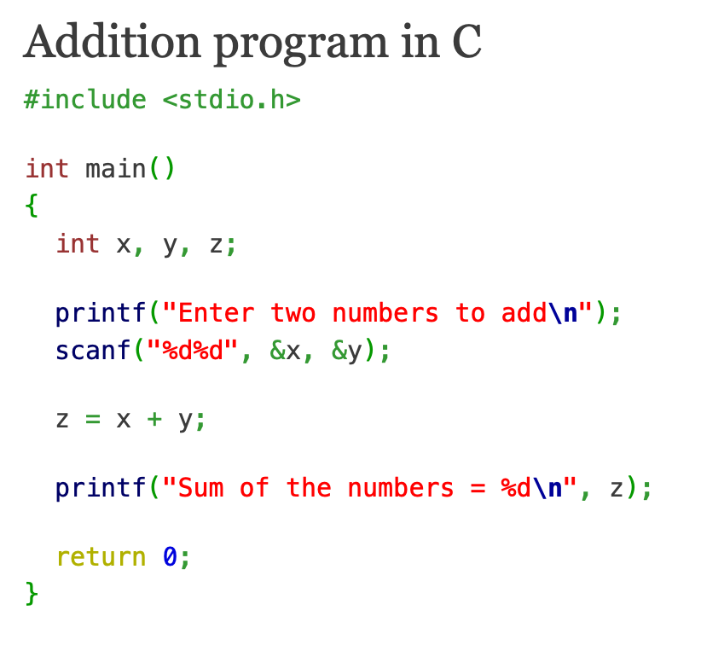
I/O at a High-level
Programmed I/O
Question: what would happen when users do not enter the two numbers?

Slide 13
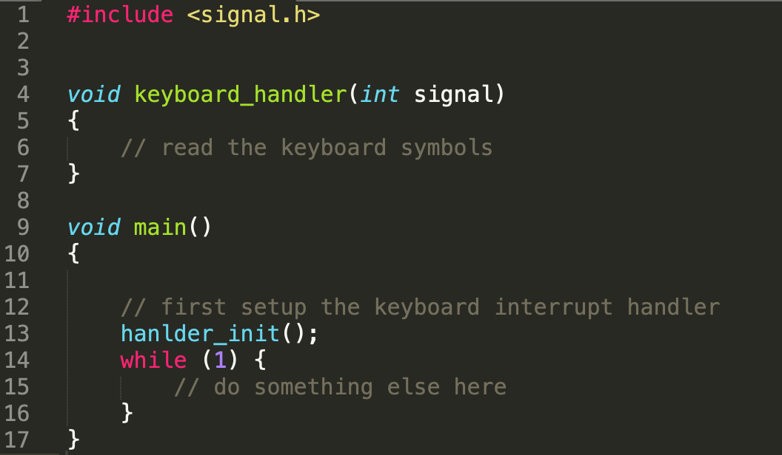
I/O at a High-level
Interrupt Driven I/O
free the CPU from waiting for the I/O event

Slide 14
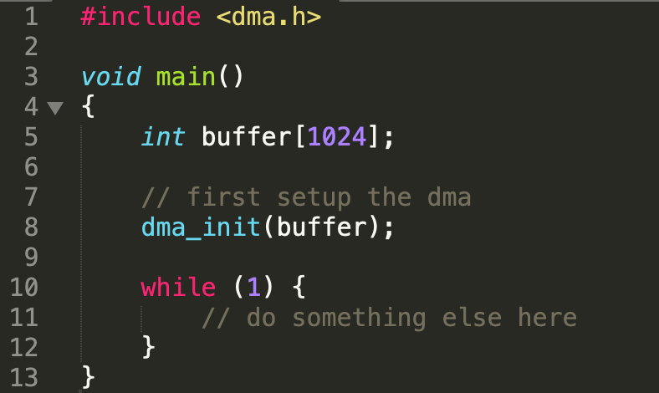
I/O at a High-level
Direct Memory Access
free the CPU from waiting for the I/O event and waiting for the data

Slide 15
Programmed I/O
CPU executes a program that gives it direct control of the I/O operation
Sensing device status
Read/write commands to the I/O module
Transferring data
CPU waits for I/O module to complete operation

Slide 16
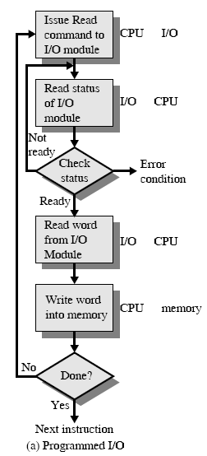
Programmed I/O - detail
CPU requests I/O operation
I/O module performs operation
I/O module sets status bits
CPU checks status bits periodically
I/O module does not inform CPU directly
I/O module does not interrupt CPU
CPU may wait or come back later (for example, with the help of time-sharing OS)

Slide 17
I/O Commands
CPU issues address
Identifies module (& device if >1 per module)
CPU issues command
Control - telling module what to do
e.g. spin up disk
Test - check status
e.g. power? Error?
Read/Write
Module transfers data via buffer from/to device

Slide 18
Addressing I/O Devices
Under programmed I/O data transfer is very like memory access (from CPU viewpoint)
Each device is given a unique identifier
CPU commands contain the identifier (address) of the corresponding module (and device)

Slide 19
Addressing Schemes Revisited
Memory mapped I/O
Devices and memory share an address space
I/O looks just like memory read/write
No special commands for I/O
Large selection of memory access commands available
Isolated I/O
Separate address spaces
Need I/O or memory select lines
Special commands for I/O
Limited set

Slide 20
Problem with Programmed I/O?
Simple, but if CPU is faster,
it is a huge waste of CPU time

Slide 21
Interrupt Driven I/O
Overcomes CPU waiting
No repeated CPU checking of device
I/O module interrupts when ready

Slide 22
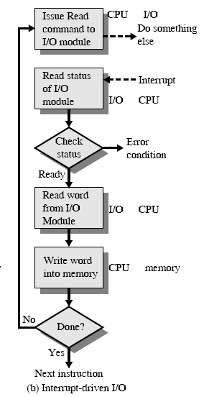
Interrupt Driven I/O Basic Operation
CPU requests I/O operation
I/O module performs operation while CPU does other work
I/O module informs CPU when something comes up by interrupting CPU
CPU deals with this event

Slide 23
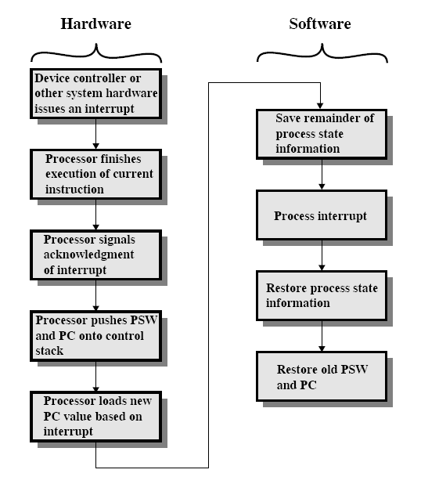

Handling an Interrupt: from a Protocol Perspective
Draw a protocol:
Which parties?
Interactions?
What’s interrupt?
New event needs CPU to handle first but CPU needs to go back to previous work after that
A program called interrupt handler
Notes:
How can the CPU know which device is generating the interrupt? What is the new PC value?

Slide 24
CPU Viewpoint
Issue read command
Do other work
Check for interrupt at the end of each instruction cycle
If interrupted:-
Save context (registers)
Process interrupt
Fetch data & store
Recover from the saved context

Slide 25
Design Issues
How can CPU know which module is issuing the interrupt?
when there are multiple devices connected to the system
How to locate the corresponding handler program when interrupted?
How do you deal with multiple interrupts?
Possible for more than one devices to issue an interrupt simultaneously or in a row

Slide 26
Identifying Interrupting Module (1)
Connect a dedicated line for each module
Limits the number of devices
Software poll
All devices share one common Interrupt Request line to interrupt CPU
Once get an interrupt, CPU asks each module in turn
CPU clears the interrupt request status of the module responsible

Slide 27
Identifying Interrupting Module (2)
Daisy Chain or Hardware poll
All devices share one common Interrupt Request line to interrupt CPU
Interrupt Acknowledge signal is sent down a chain
Bus Master
Module must claim the bus before it can raise interrupt
e.g. PCI & SCSI
Interrupt controller
8259

Slide 28
Locating Handler Programs
Using a general handler program
CPU enters this handler every time it gets interrupted
looks for the module responsible and gets the address of the corresponding handler program
Using interrupt vectors
instead of using fixed locations, a handler program can be stored anywhere in memory
a pointer is used to link to the handler program
the address of the pointer is fixed and known to CPU
such pointers are interrupt vectors
Pros and cons?

Slide 29
Dealing with Multiple Interrupts
Set priorities for interrupts
i.e., high-priority interrupts get served first
Given a interrupt identification scheme, how to set priorities?
Software and hardware polling, bus mastering
Nesting of interrupts
i.e., high-priority interrupts can further interrupt low-priority interrupts

Slide 30
Problem with Programmed and Interrupt-driven I/O?
They both need the involvement of CPU.

Slide 31
Direct Memory Access
Interrupt driven and programmed I/O require active CPU intervention
Transfer rate is limited
CPU is tied up
DMA is the answer

Slide 32
DMA Function
Additional Module (hardware) on bus
DMA controller takes over from CPU for I/O

Slide 33
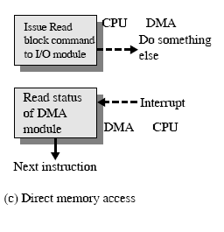
DMA Operation
CPU tells DMA controller:-
Read/Write
Device address
Starting address of memory block for data
Amount of data to be transferred
CPU carries on with other work
DMA controller deals with transfer
DMA controller sends interrupt when finished

Slide 34
DMA Transfer Cycle Stealing
In an instruction cycle, the processor may be suspended due to DMA operation
CPU suspended just before it accesses bus
DMA controller takes over bus for a cycle
Transfer of one word of data
Not an interrupt: CPU does not switch context
Slows down CPU but not as much as CPU doing transfer

Slide 35
DMA Configurations (1)
DMA
Controller
I/O
Device
I/O
Device
Main
Memory
CPU
Single Bus, Detached DMA controller
Each transfer uses bus twice
e.g., I/O to DMA then DMA to memory
For one transfer, CPU is suspended twice

Slide 36
DMA Configurations (2)
DMA
Controller
DMA
Controller
Main
Memory
CPU
I/O
Device
I/O
Device
I/O
Device
Single Bus, Integrated DMA controller
Controller may support >1 device
Each transfer uses bus once
DMA to memory
For one transfer, CPU is suspended once

Slide 37
DMA Configurations (3)
CPU
DMA
Controller
Main
Memory
I/O
Device
I/O
Device
I/O
Device
I/O
Device
Separate I/O Bus
Bus supports all DMA enabled devices
Each transfer uses bus once
DMA to memory
For one transfer, CPU is suspended once

Slide 38
Which way is the best?
Simplicity
Performance

Slide 39
Understand Different I/O from the Hardware/Software
Interaction with I/O Device | Programmed I/O | Interrupt-driven I/O | Direct Memory Access
Waiting for the Device | Software (instructions running on the CPU) | Hardware | Hardware
Transfer the Device Data to the Memory | Software | Software | Hardware

Slide 40
Assignment Three
Computer Organization and Architecture 8e by William Stallings
Problem 7.8, 7.9, 7.10 (a, b)

